Slide 1
TEACHER CUE
CFU
HINT
Scaffolding for students
MAKE THE CONNECTION
Allow students to make the connection

Slide 2
SWBAT define current, voltage and resistance
TRACK WITH ME
READ WITH ME
I can give a definition of resistance, current and voltage
I know what voltage, current and resistance are measured in

Slide 3
MAKE THE CONNECTION
Energy transfer through different mediums can be explained using wave and particle models (ACSSU182)

Slide 4
MAKE THE CONNECTION
Describe the process in which we generate electricity

Slide 5
Voltage is the difference in the electric potential across two points.
It is often the pressure of the power source that pushes charged electrons around a circuit.
Voltage = Pressure and measured in volts.

Slide 6
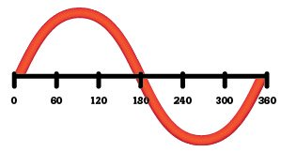
MAKE THE CONNECTION
Which type of electricity is in your car? Which type of electricity powers your home?
Voltage can have two forms:
Alternating current (AC)
This reverses at regular intervals.
Commonly produced via generators that have a rotating shaft
Direct current (DC)
Travels in a straight line in one direction.
Commonly produced via batteries

Slide 7
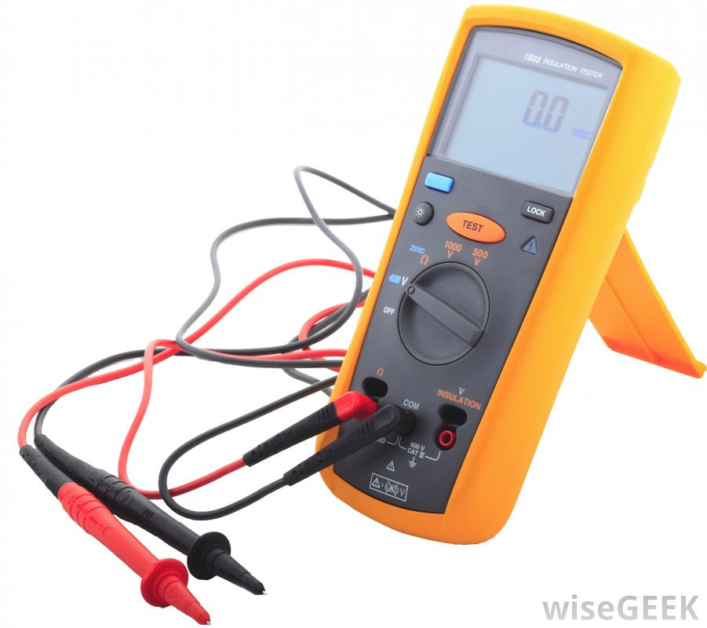
Current is a measure of how many electrons flow through a surface.
Current is measure in amps.
What charge is an electron?
What charge is electrons attracted to?

Slide 8
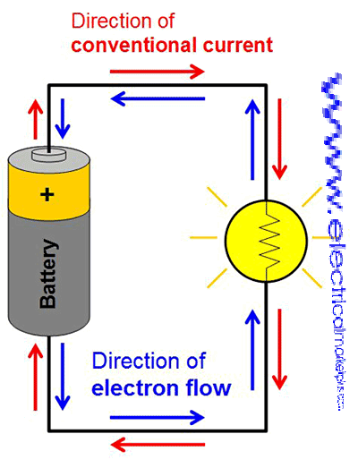
In the image:
Free electrons move through the wire
Electrons flow from the negative terminal of a battery to a positive terminal
Electrical current flows in the opposite direction

Slide 9
Resistance is a measure of how a device reduces the electrical current through it.
Resistance is measured in ohms.
Things that cause resistance can be ions, which when electrons collide with metal wires, make it more difficult for current to flow.

Slide 10
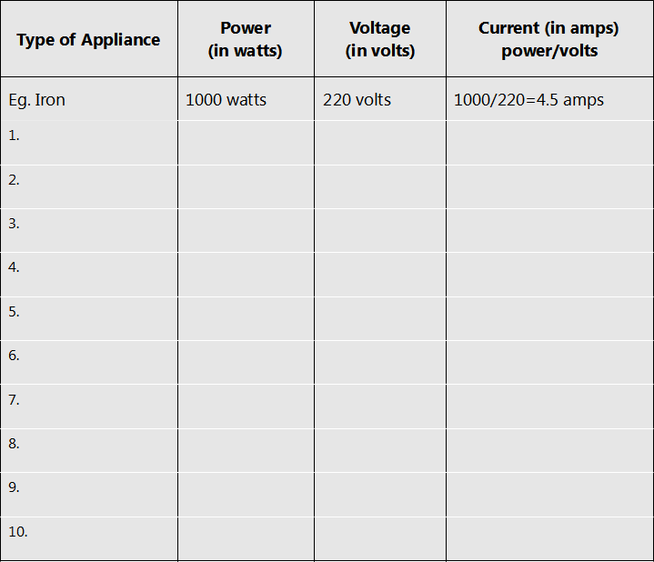
Homework task: Draw the table in your book or on a spare piece of paper and investigate the voltage, power and current of different appliances in the home

Slide 11
TRACK WITH ME
READ WITH ME

